Slide 1

Fire Watch - Final Update
Using Convolutional Neural Networks to Prevent Wildfires
Carter Elliott & Steven Nguyen in Partnership with Perimeter Platform

Slide 2
A Quick Refresher...
Convolutional Neural Networks (CNN) can be used to classify fires, which can be used to detect and alert others about small fires before the become infernos
Data gathered from the FLAME Dataset can be used to train a model to identify different sized fires using thermal images extracted from a thermal video
We started creating different models, but couldn’t get above a 45.70% accuracy

Slide 3

Machine Learning Checklist
Frame the problem and look at the big picture
Get the data
Explore the data to gain insights
Prepare the data to better expose underlying patterns to ML algorithms
Explore many different models and short list the best ones
Fine tune models and combine to make great solution
Present the solution
Launch, monitor, and maintain the system

Slide 4
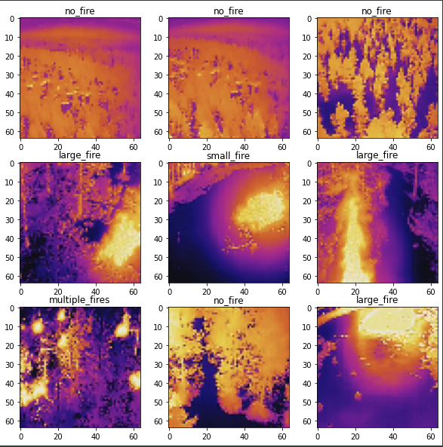
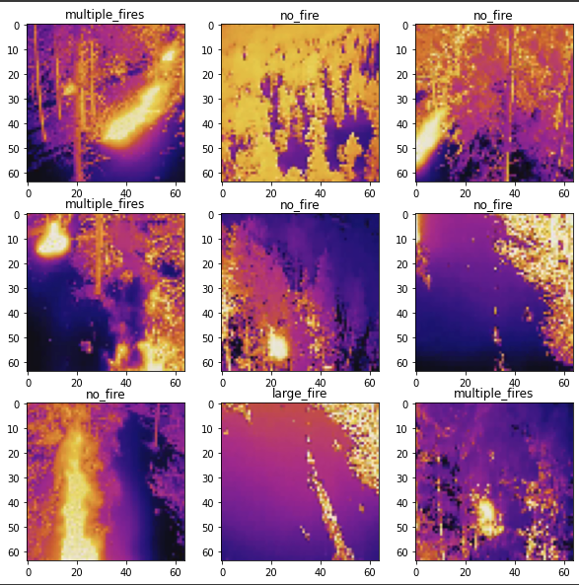
So…What Happened?
Creation of Batch Dataset
Creation of NumPy Dataset

Slide 5
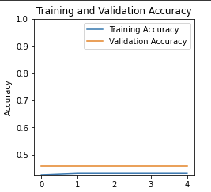
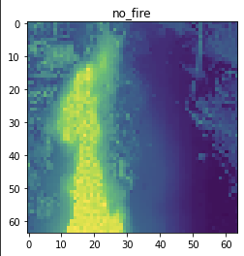
Crash and Burn…
Creation of NumPy Dataset

Slide 6
Major Fires Put Out
Restructured the NumPy Conversion Process
Previous conversion stripped labels from images
Main reason as to why the accuracy was so low - the model had no labels to work with!
Added More Dense Layers
Abrupt change from 128 to 4 Neurons allowed for more mistakes to happen
Contributed to decreased accuracy on the original model
Modified Filter Sizes on Convolutional Layers
Small Filter (32) to Large Filter (64) did not collect enough information before moving on, decreasing accuracy
Presence of Hot Spot vs No Hot Spot (Great for Binary Classification!)
Shape and Size of Flame
Presence of Multiple Fires
Changed the Kernel Size on Convolutional Layer #2
Original Kernel Size was (3, 3), which was too big for the filtered images from CL #1
Decreased Accuracy

Slide 7
Explore Many Different Models…
To obtain the BEST model possible, extensive hyperparameter tuning and testing was conducted:
Started with Level of Classification
Binary, Trinary, and Quadinary
Tested with 6 Different Models with Different Hyperparameters; recorded results
Get a holistic image what parameters had the most impacts
Shortlisted the Top 2 of Each Level
Restarted Colab and Ran Tests with ONLY THOSE PARAMETERS
Clean slate for most objective results
Picked BEST Model
High Accuracy (with Test Set)
Low Loss (with Test Set)
No Overfitting with Accuracy/Loss Graphs
Used Parameter of Winner as Baseline Parameters for Next Classification Level
https://docs.google.com/spreadsheets/d/14GAvady1-Ao20qM3-EMf-2xQ3vZ-pDyS5zsBr4kTkq8/edit#gid=903834163

Slide 8
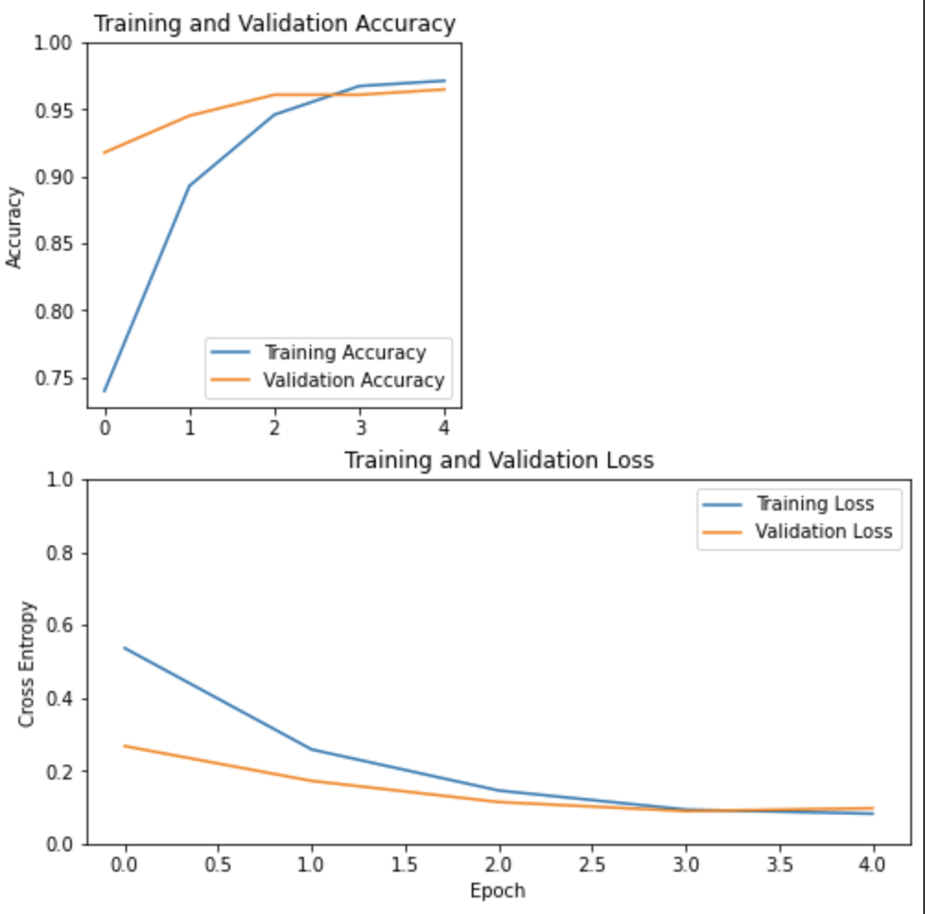
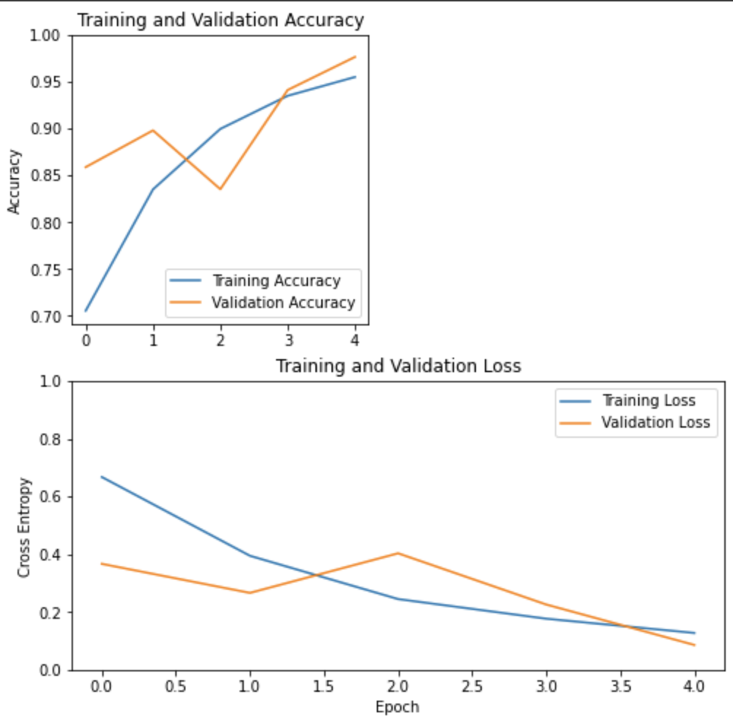
Binary Models - Top 2
Fire vs. No Fire
Model 3 - CL #1: 32 Filters, CL #2: 64 Filters
Model 5 - CL #1: 64 Filters, CL #2: 32 Filters)

Slide 9
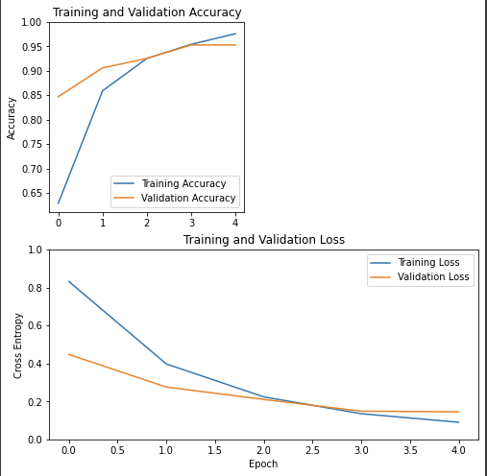
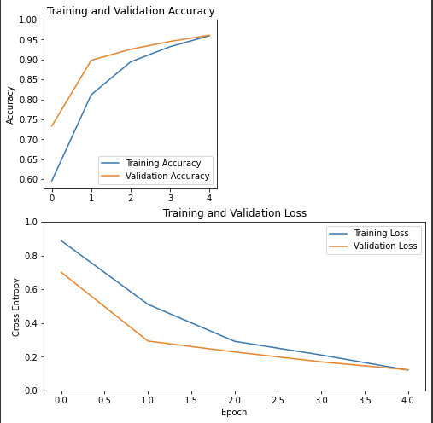
Trinary Models - Top 2
No Fire vs. Single Fire vs. Multiple Fires
Model 2 - CL #1: 64 Filters, CL #2: 32 Filters
Model 5 - CL #1: 64 Filters, CL #2: 32 Filters, CL #3: 16 Filters)

Slide 10
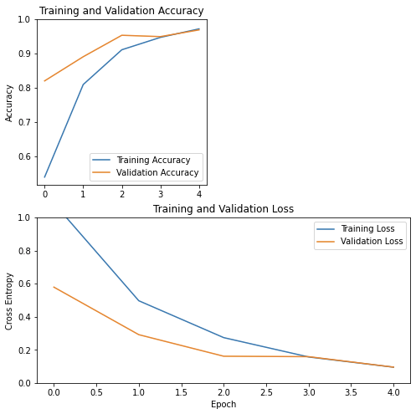
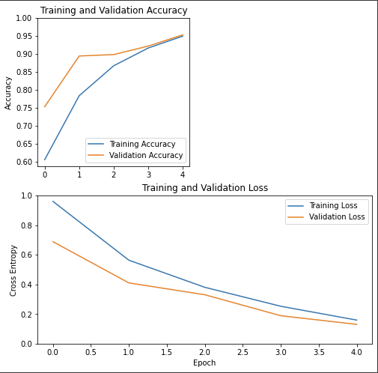
Quaternary Models - Top 2
No Fire vs. Small Fire vs. Large Fire vs. Multiple Fires
Model 3 - CL #1: 64 Filters, CL #2: 32 Filters
Model 6 - CL #1: 64 Filters, CL #2*: 32 Filters, CL #3: 16 Filters
*Includes Zero Padding

Slide 11
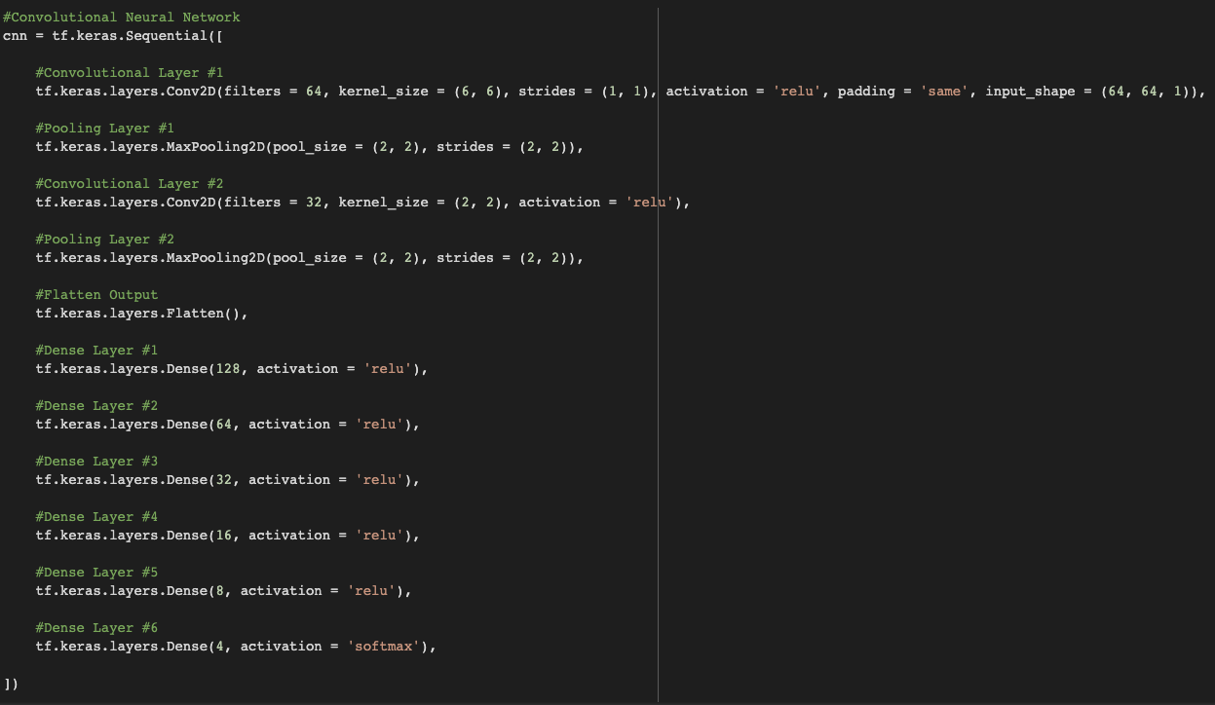
Presenting…”Smokey The Bear”!

Slide 12
Testing “Smokey The Bear”
To obtain a better perspective on the performance of the final model, we conducted multiple trials and analyzed the averages:
Factory Reset the Notebook
Keep things as clean and objective as possible
Conducted 10 Trials
Re-Ran from “The Model” to “Make A Prediction” sections in the Notebook
Recorded Results for Every Epoch from Each Trial
Loss, Validation Loss, Accuracy, and Validation Accuracy - Training Set
Loss, Accuracy, Overfitting Graphs (Loss/Accuracy) - Testing Set
Got the Averages of Each Epoch + Recorded
Loss, Validation Loss, Accuracy, and Validation Accuracy - Training Set
Loss and Accuracy - Testing Set
Created Accuracy + Loss Graphs Based on Averages

Slide 13
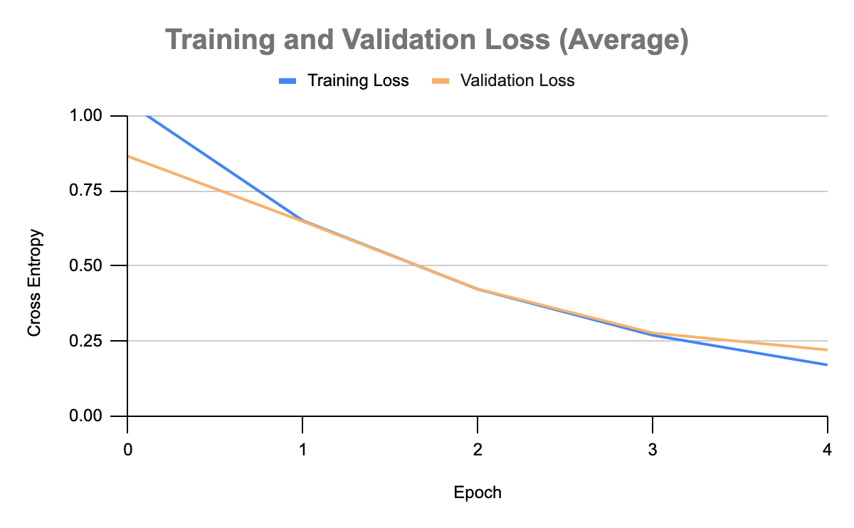
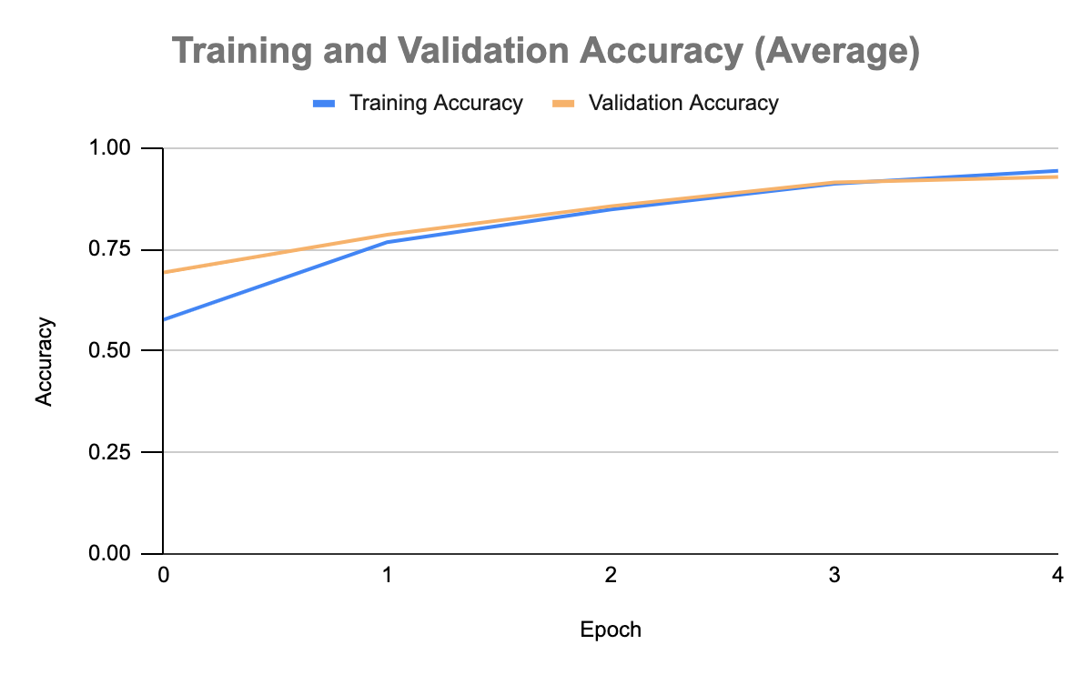
Results of “Smokey The Bear”
With Regard to the Test Set:
Loss: 0.18239 (Average)
Accuracy: 94.98% (Average)

Slide 14
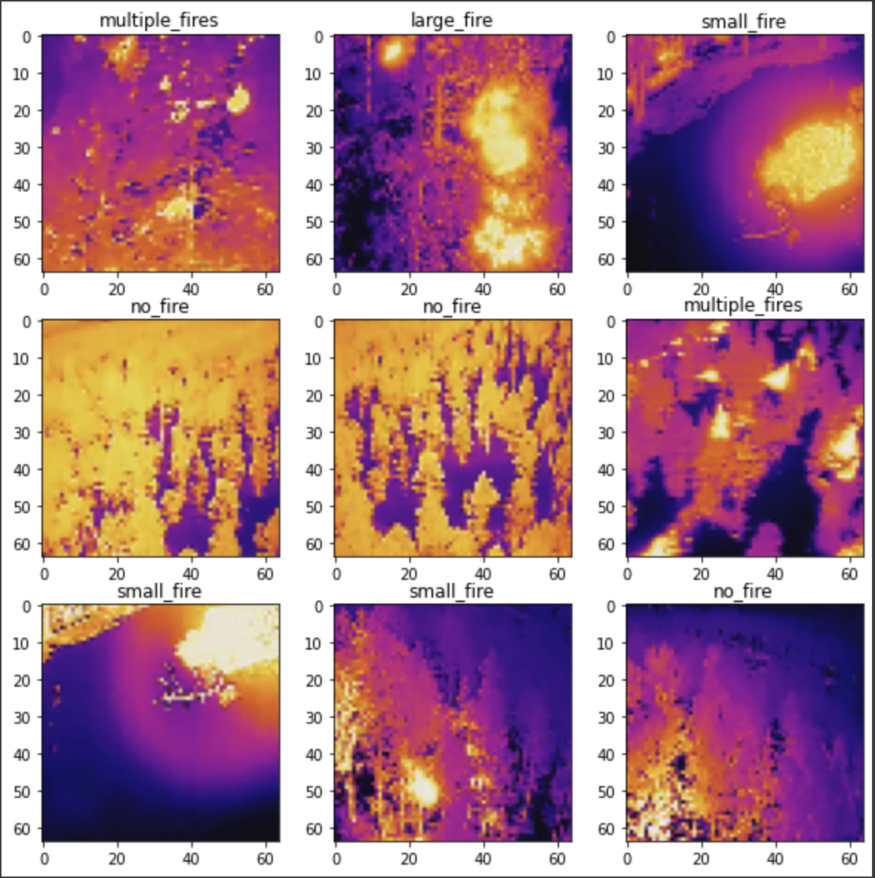
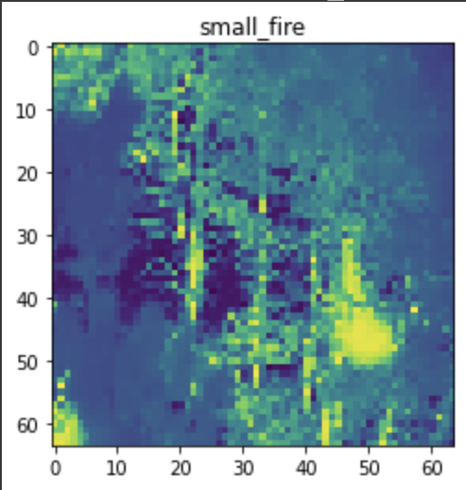
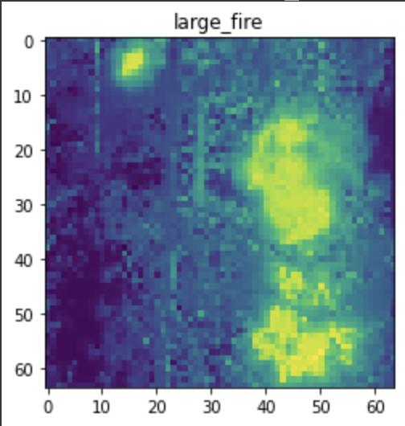
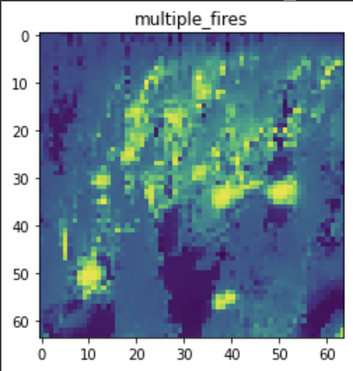
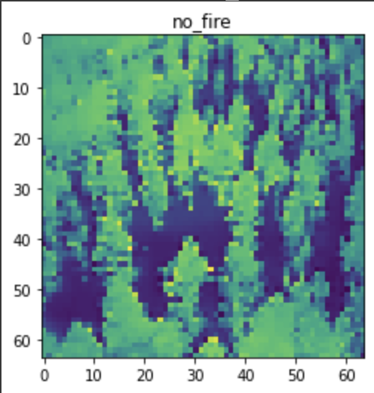
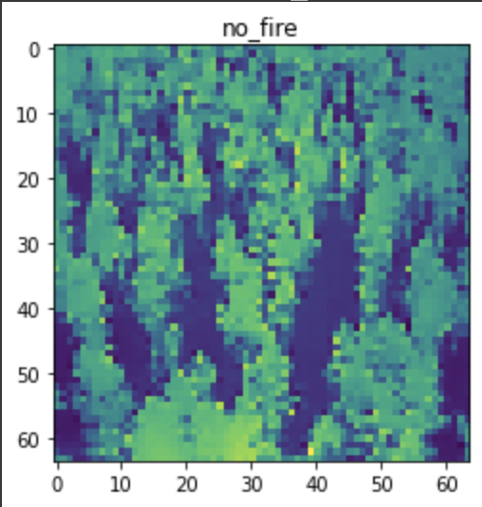
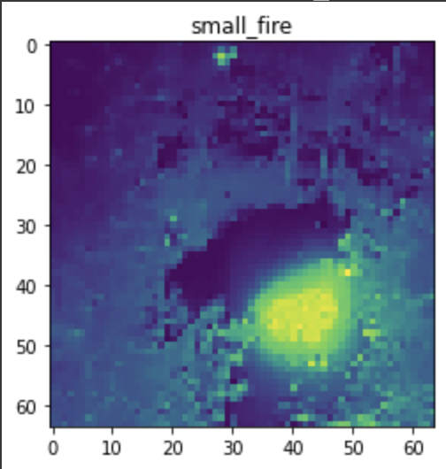
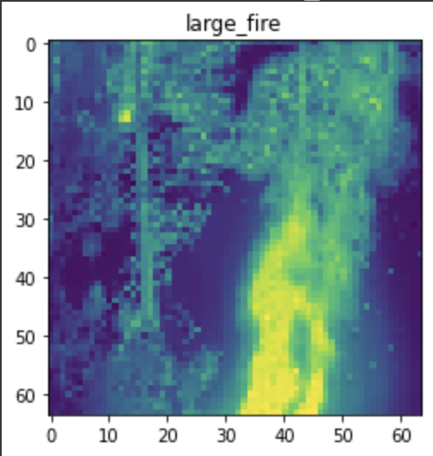
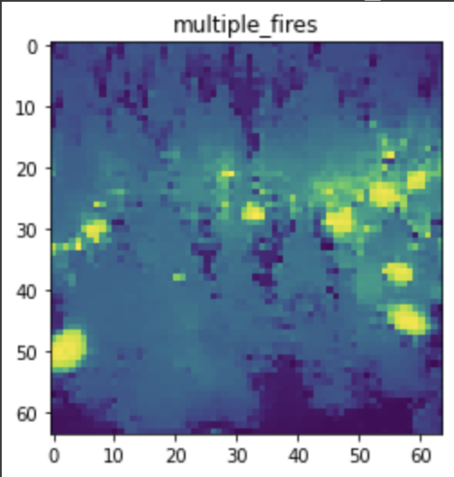
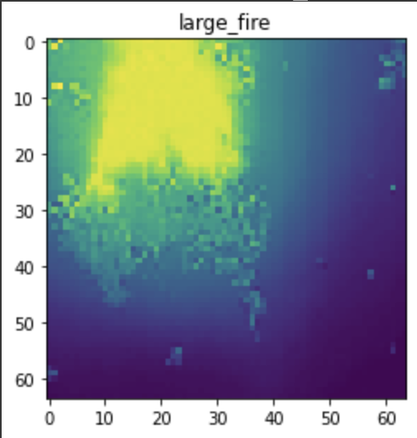
SUCCESS!!!
First 9 Images of Testing Set
9 Randomly Predicted Images

Slide 15
Colab Notebook Demo:
https://colab.research.google.com/drive/1IURan__-glEq4jqfuWz9o3evef9NxvDj?usp=sharing

Slide 16
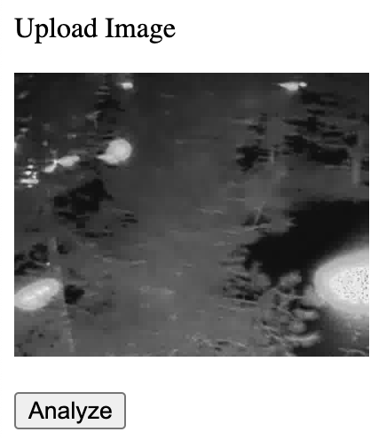
Launching “Smokey The Bear”
We decided to use Netlify to deploy our model
Got major files needed to deploy
HDF5 File: stb.h5
Bin File: group1-shard1of.bin
JSON File: model.json
Zipped files and uploaded to Netlify
User can upload images; displays preview of image
As much as tried to get it working (and wanted it to be), we couldn’t get proper predictions to be made…
https://lucid-lichterman-67ff6a.netlify.app/

Slide 17
Acknowledgements
We would like to thank a few people for helping make this project possible…
Teate
Bailey and Noah (Perimeter)
Various authors of articles
Various YouTube Content Creators

Slide 18
Questions?

